Slide 1

Skills for Success with Microsoft Office 2016 Volume 1
by Margo Chaney Adkins, Catherine Hain, Lisa Hawkins, and Stephanie Murre Wolf
Access Chapter 2
Create Select Queries
Notes:
Skills for Success with Microsoft Office 2016 Volume 1

Slide 2
Skills
Create Queries with the Simple Query Wizard
Add Text Criteria
Add Calculated Fields to Tables
Create Queries in Design View
Add Comparison Operators
Notes:
The skills of this chapter are:
Create Queries with the Simple Query Wizard
Add Text Criteria
Add Calculated Fields to Tables
Create Queries in Design View
Add Comparison Operators
The skills continue on the next slide.

Slide 3
Skills (cont.)
6. Add Date and Time Criteria
7. Group and Total Queries
Add Calculated Fields to Queries
Work with Logical Operators
Add Wildcards to Query Criteria
Notes:
Additional skills include:
Add Date and Time Criteria
Group and Total Queries
Add Calculated Fields to Queries
Work with Logical Operators
Add Wildcards to Query Criteria

Slide 4
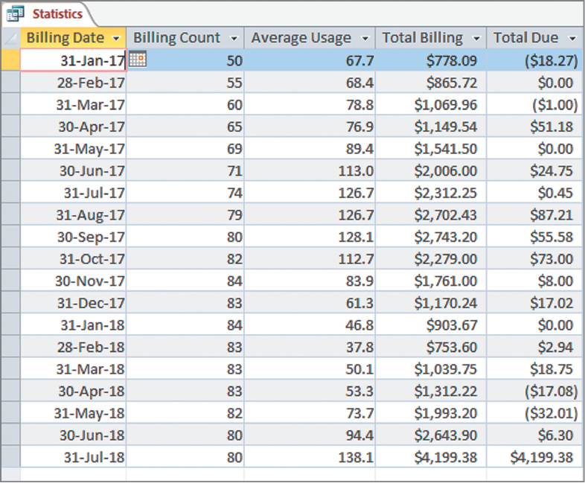

Outcome
Notes:
Using the skills in this chapter, you will create an Access query like this.

Slide 5
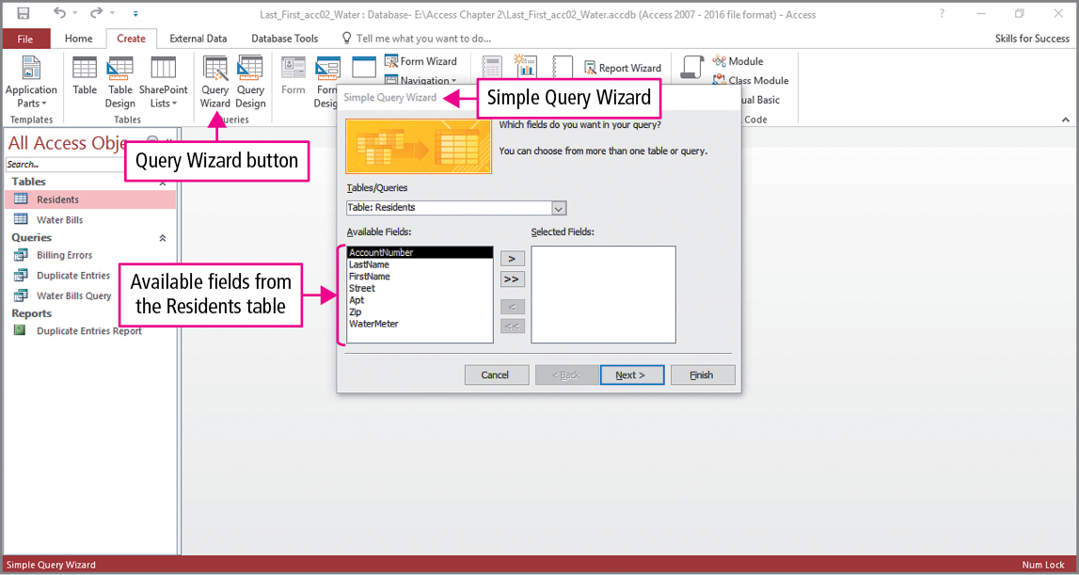
Skill 1: Create Queries with the Simple Query Wizard
Notes:
A query is used to ask questions about the data stored in database tables. A select query selects and displays the records that answer the question without changing the data in the underlying table or tables.
We will use the Query Wizard to create our first query. Click Query Wizard in the Queries group on the Create tab to open the New Query dialog box. In the first step in the dialog box, select Simple Query Wizard, which displays the image shown on the slide. As seen in the slide, a table is selected and the table’s fields are displayed in the Available Fields box.

Slide 6
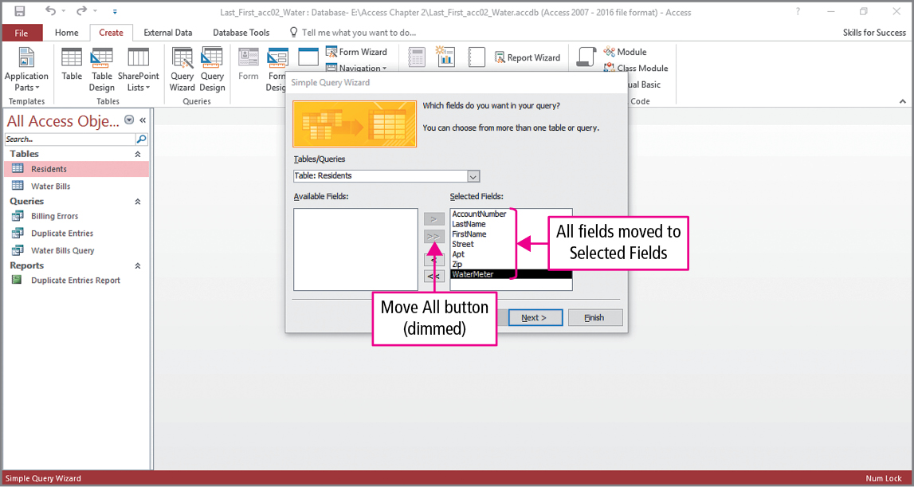
Skill 1: Create Queries with the Simple Query Wizard (cont.)
Notes:
Fields can be moved individually from the Available Fields box to the Selected Fields box by clicking the Move button, or all the fields can be moved by clicking the Move All button. Once the fields have been selected, you name the query and then view the query results.

Slide 7
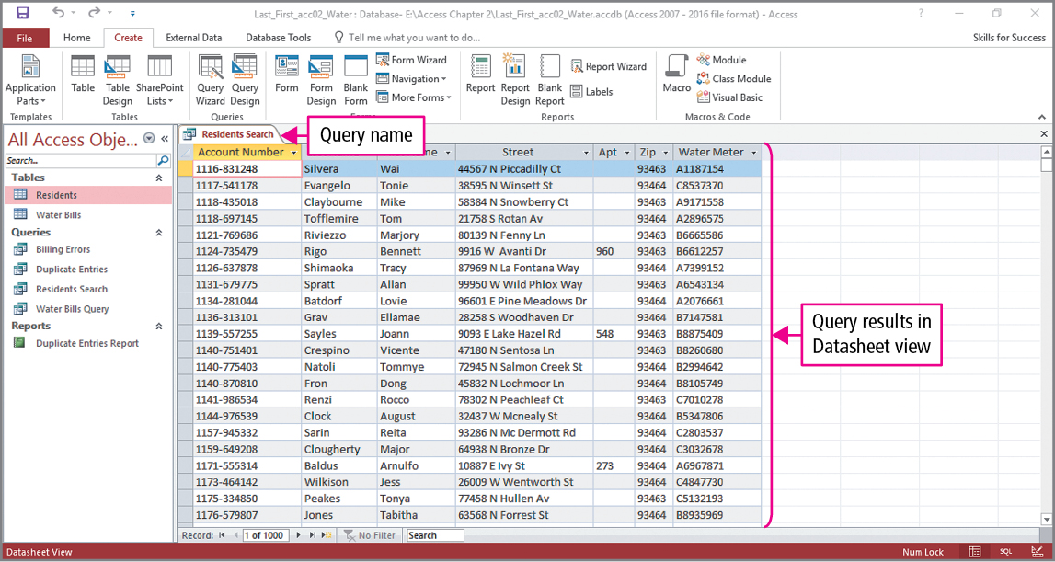
Skill 1: Create Queries with the Simple Query Wizard (cont.)
Notes:
This slide shows the results in Datasheet view. Since we selected all the fields, this query displays the entire table.

Slide 8
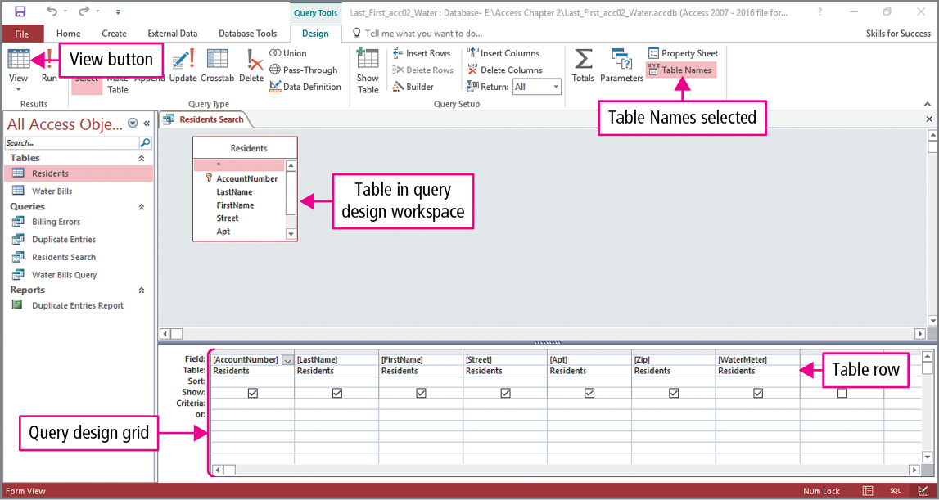
Skill 2: Add Text Criteria
Notes:
We are going to improve the query by adding some criteria, which are conditions in a query used to select the records that answer the query’s question. Click the View button to switch to Design view.
Notice there are two panes:
The query design workspace which displays the tables used in the query.
The query design grid which displays the fields and settings

Slide 9
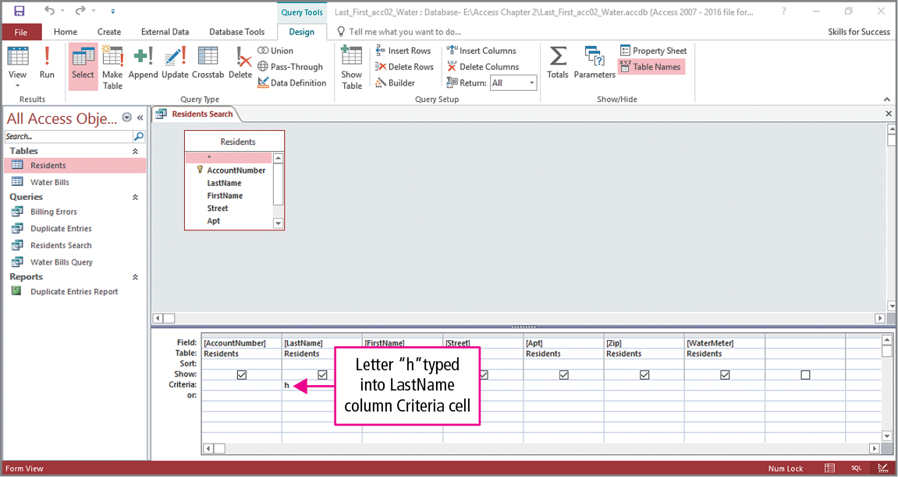
Skill 2: Add Text Criteria (cont.)
Notes:
When typing in the criteria row, IntelliSense—Quick Info, ToolTips, and AutoComplete boxes—displays guidelines for the feature you are typing.
AutoComplete is a menu of commands that match the characters you type.
The Quick Info message explains the purpose of the selected AutoComplete command.
The slide shows an example where the letter ‘h’ is typed into the intersection of the LastName column and Criteria row.

Slide 10
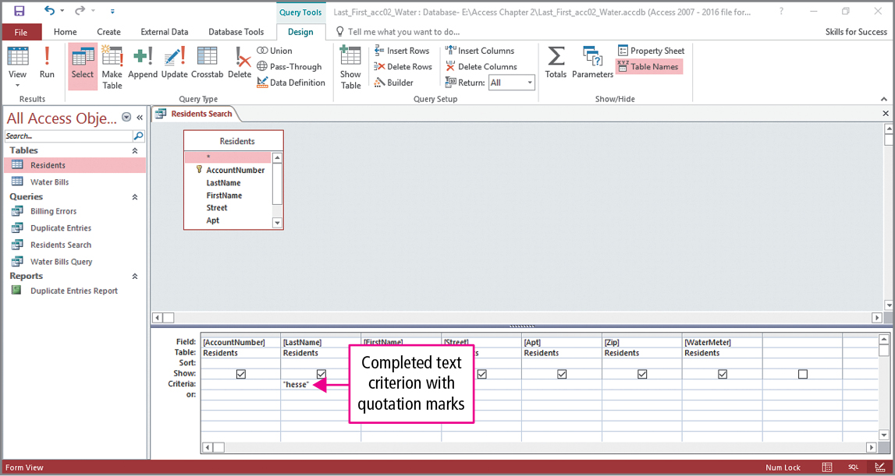
Skill 2: Add Text Criteria (cont.)
Notes:
The slide shows that the remainder of the name has been typed. Note the presence of the quotation marks. Criteria that contain text must be surrounded by quotation marks. If you do not type them, they will be automatically inserted before the query is run. For the database shown here, this query would display three persons whose last name is hesse.

Slide 11
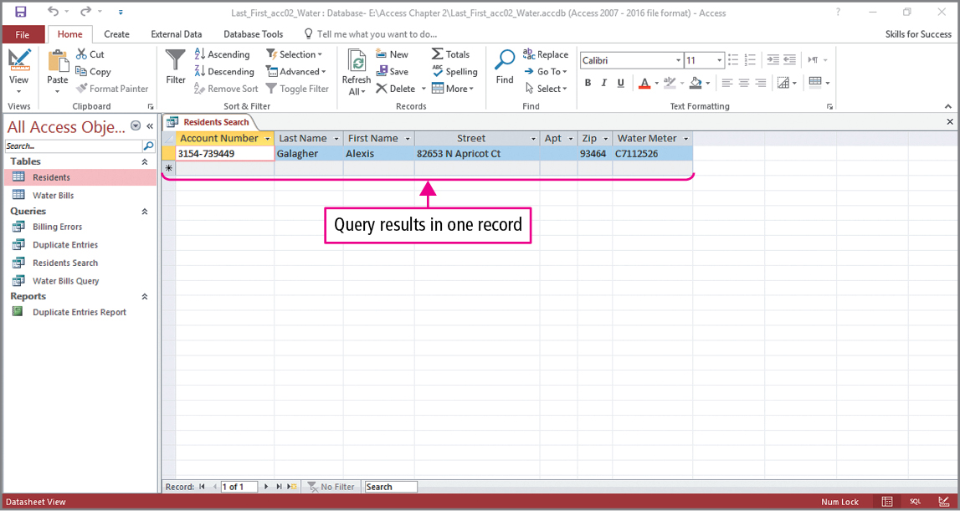
Skill 2: Add Text Criteria (cont.)
Notes:
For the final example of this query, hesse is selected and deleted, and new criteria are entered. C7112526 has been typed into the criteria row in the WaterMeter column. The result of the query is shown in the slide. What question does this query answer? It tells us who has that water meter and where they live.

Slide 12
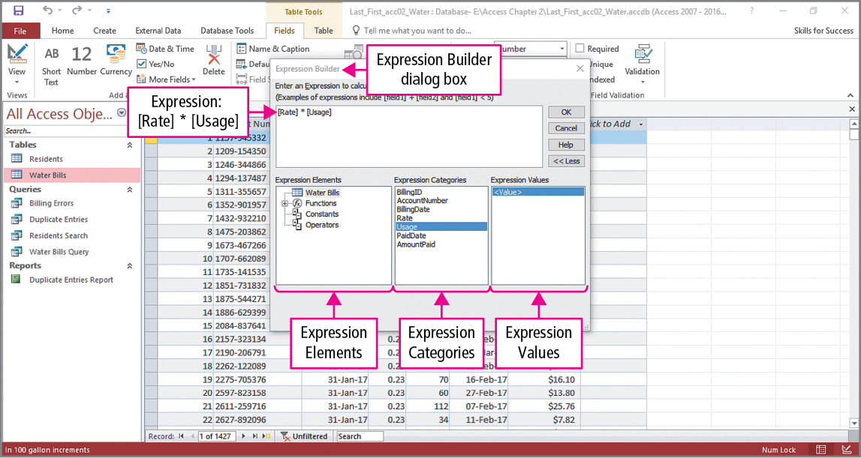
Skill 3: Add Calculated Fields to Tables
Notes:
A calculated field is a field in a table or query that derives its values from other fields in the table or query. For this example, we will create a calculated field that determine water bills, which are based on the rate and usage columns.
An expression is a combination of fields, mathematical operators, and pre-built functions that calculates values in tables, forms, queries, and reports.
In the background of this slide, the Water Bills table has been opened in Datasheet view. We will use the Expression Builder tool to construct a calculated field. Select the Usage field, click More Fields in the Add & Delete group on the FIELDS tab, in the field list point to Calculated Field, and then in the submenu click Currency. This opens the Expression Builder dialog box shown in the foreground of the slide. A calculated field is created by selecting items from the various boxes or by directly typing the expression.
Under Expression Elements, click Operators, and then under Expression Categories, click Arithmetic. Under Expression Values, double-click the multiplication operator to insert it into the expression. Under Expression Elements, click Water Bills, and then under Expression Categories, double-click Usage. The result of these actions is shown in the top box. Notice that Access has surrounded the field names in brackets.

Slide 13
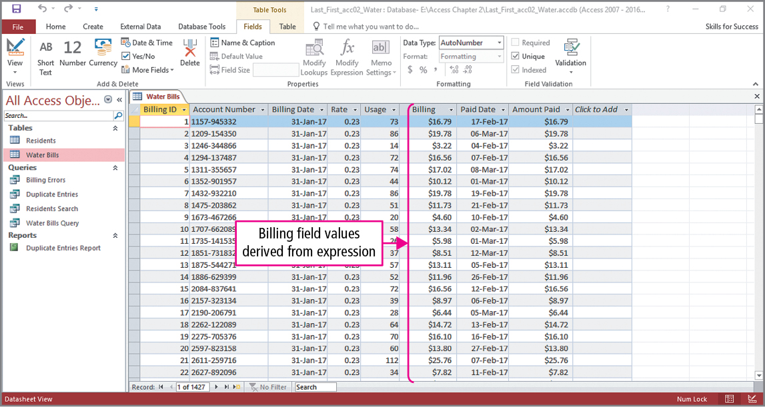
Skill 3: Add Calculated Fields to Tables (cont.)
Notes:
All that remains is for us to name the calculated field, and as shown in the slide, it has been named Billing. If you have a calculator available, check one of the calculations by multiplying any rate times the usage.

Slide 14
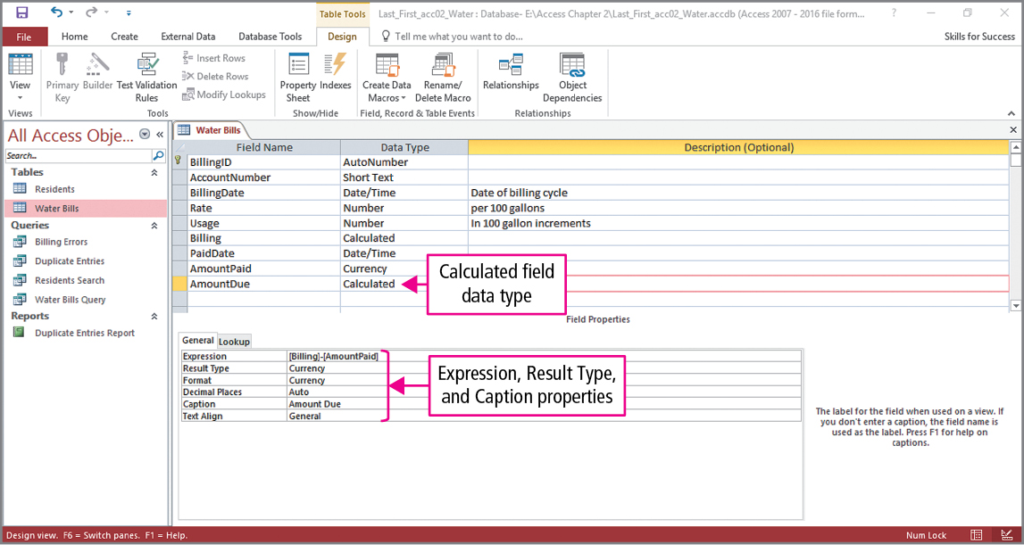
Skill 3: Add Calculated Fields to Tables (cont.)
Notes:
Switching to Design view, we create another calculated field, which will determine the amount due on the water bills. This is done by clicking an empty cell, naming the field, and setting its data type. Clicking the Data Type arrow displays a list from which Calculated is selected. This opens the Expression Builder, and as we saw previously, you can add components by selecting them or by simply typing the expression yourself. Using the example in the text, the new field is called AmountDue, and the calculated expression is: [Billing] ‐ [AmountPaid]. One additional step is shown in the Field Properties pane, where the result type is set to Currency.

Slide 15
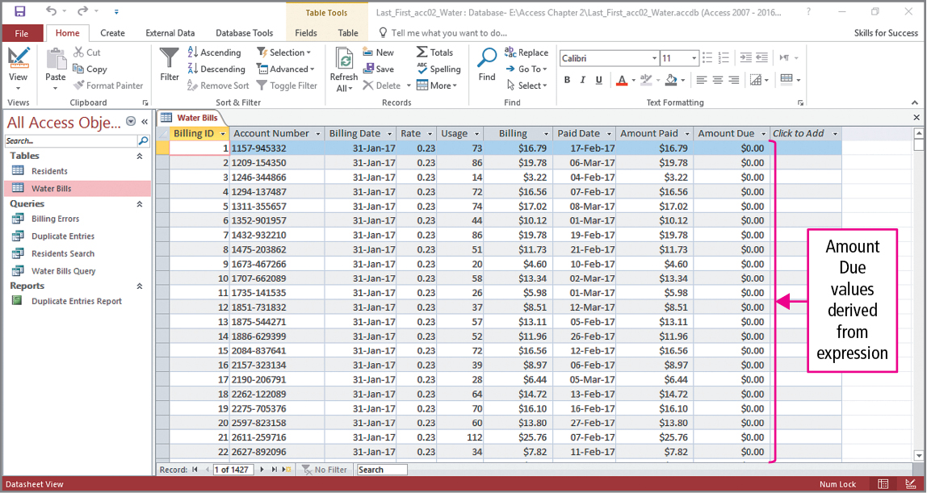
Skill 3: Add Calculated Fields to Tables (cont.)
Notes:
The final slide shows the results in the Datasheet view. Since all the bills have been paid, you do not need your calculator to check this calculated field.

Slide 16
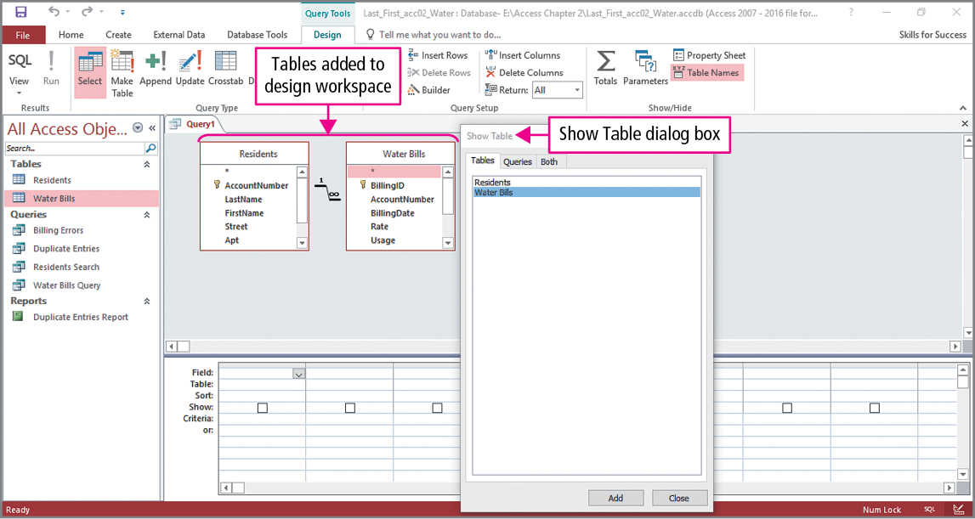
Skill 4: Create Queries in Design View
Notes:
This time we will create a query using Design view. The query question is: What are the names of the customers that have an overdue balance, what are those balances, and from what time periods?
Click the Query Design button in the Queries group on the Create tab. To add tables to the query design workspace, you double-click the table(s) displayed in the Show Table dialog box. In this example, both the Residents and Water Bills tables will be added.

Slide 17
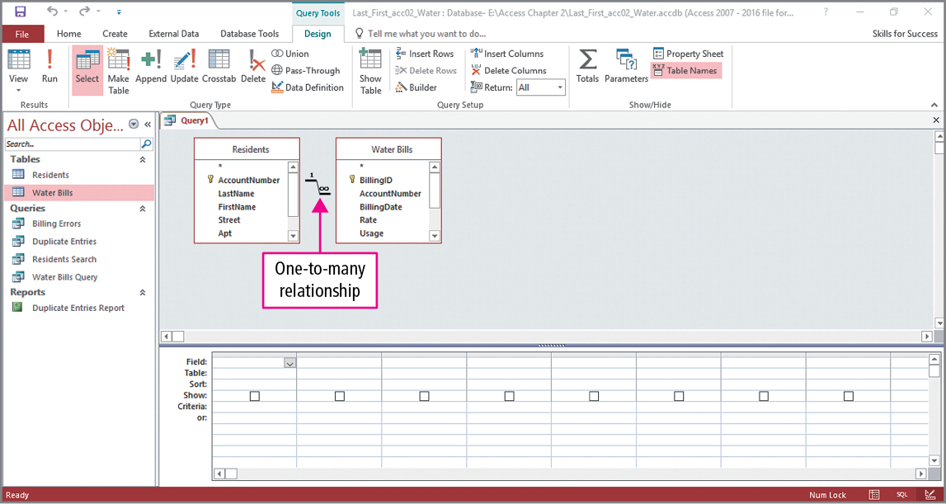
Skill 4: Create Queries in Design View (cont.)
Notes:
To answer our question, the query will use some fields from both these tables. When a query uses fields from multiple tables, the tables need to be related.

Slide 18
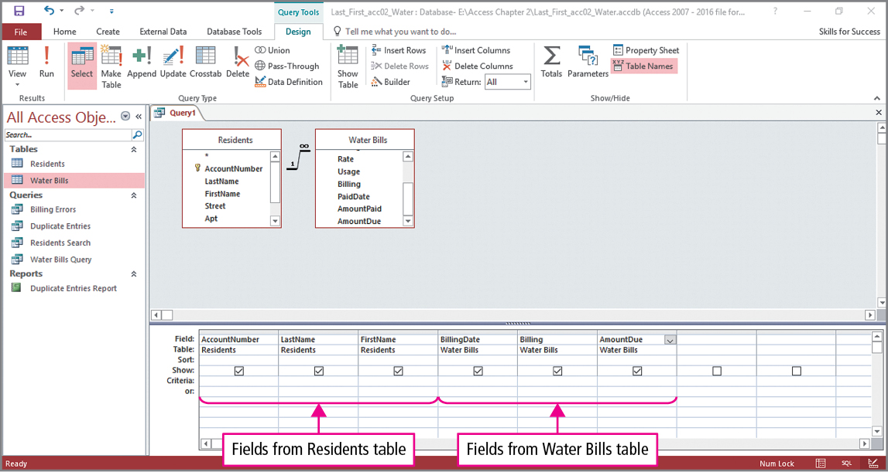
Skill 4: Create Queries in Design View (cont.)
Notes:
The fields shown in the query design grid were dragged from the tables in the query design workspace. As seen in the slide, there are fields taken from both tables.

Slide 19
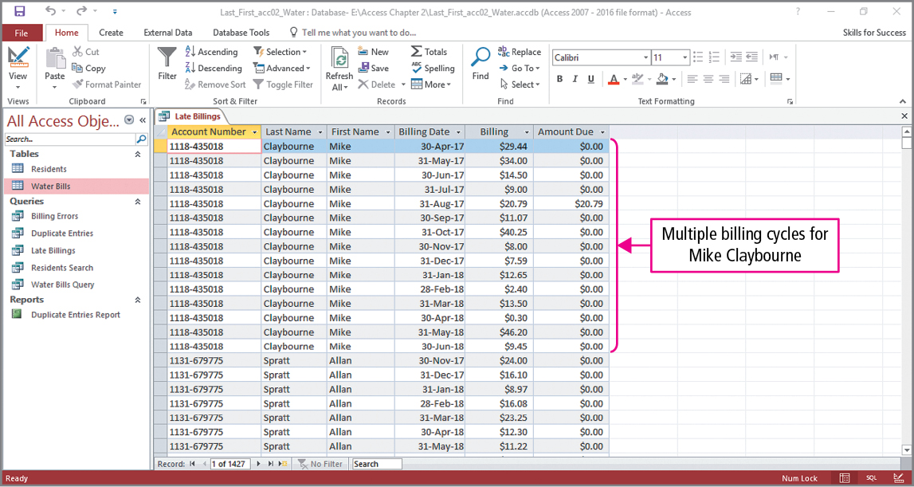
Skill 4: Create Queries in Design View (cont.)
Notes:
The results of running the query are shown in the slide. All the records are displayed, since we have not entered any criteria.

Slide 20
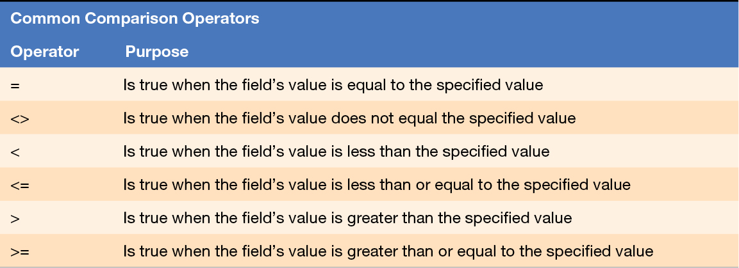
Skill 5: Add Comparison Operators
Notes:
In query criteria, numbers are typically combined using comparison operators—operators that compare two values including operators such as = (equal) and > (greater than). Looking at the table, you should recognize some of the operator symbols. You may wonder why less than or equal to is not written as ≤. Try finding that key on a keyboard, and you will understand why the two symbols <= are used.

Slide 21
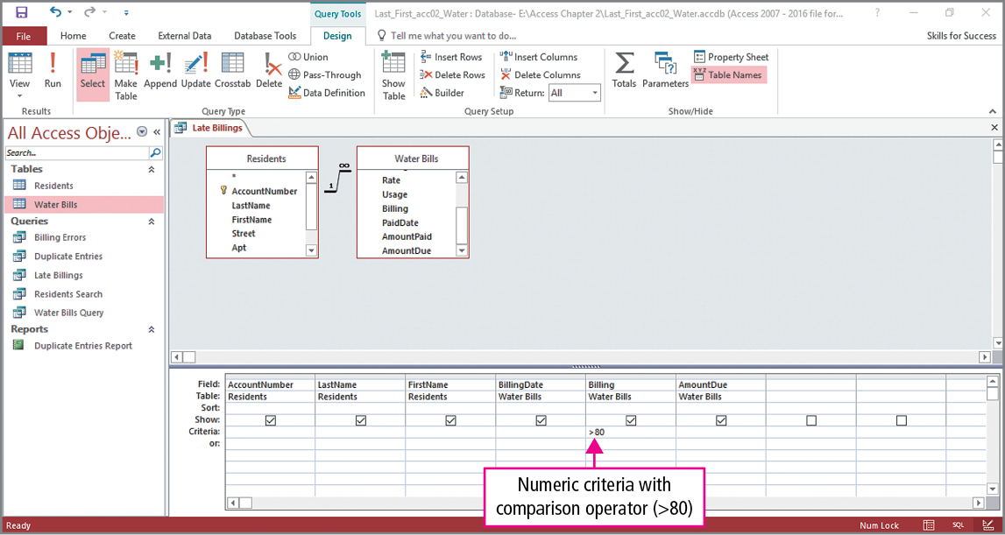
Skill 5: Add Comparison Operators (cont.)
Notes:
We will experiment with some of these operators. The example shown in this slide uses greater than 80 in the billing field. If run, the query would show customers whose bills exceed $80.

Slide 22
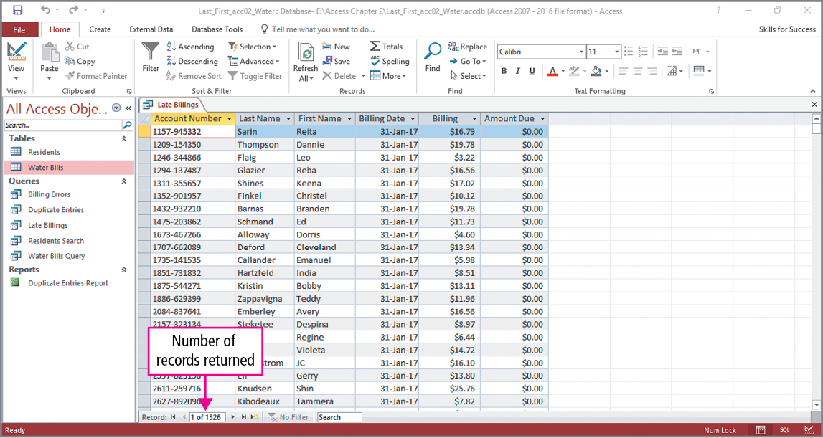
Skill 5: Add Comparison Operators (cont.)
Notes:
The next example uses less than or equal to 0 in the criteria row in the Amount Due column, and the results are shown in the slide. What question would this query answer?

Slide 23
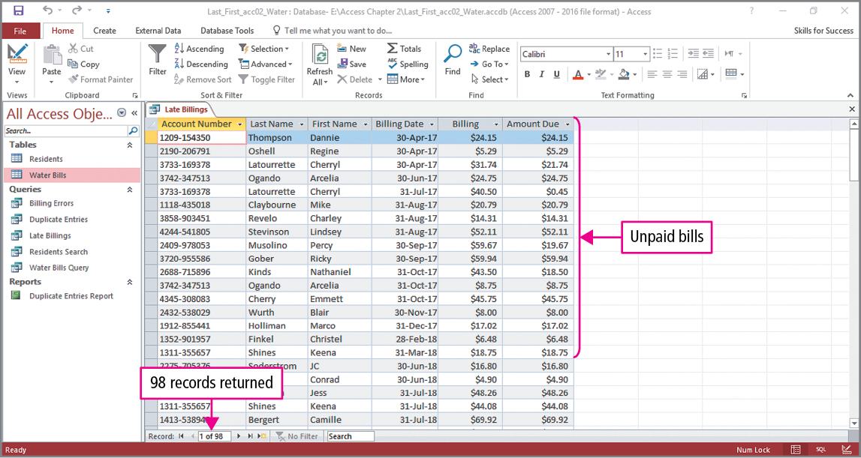
Skill 5: Add Comparison Operators (cont.)
Notes:
Our final example uses greater than 0 in the criteria row in the Amount Due column, and the results are shown in the slide. As indicated, the displayed records are for customers who have a balance due. We know they have a balance due, but is the balance overdue?

Slide 24
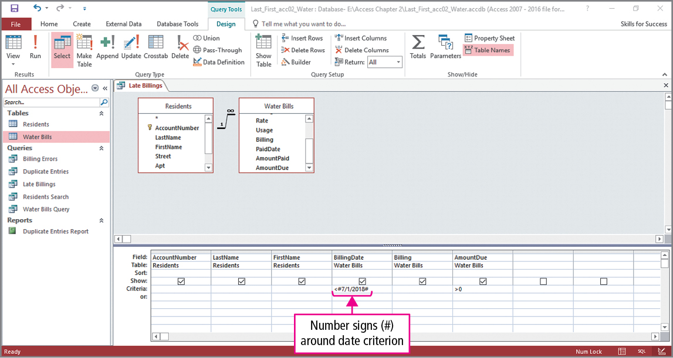
Skill 6: Add Date and Time Criteria
Notes:
Access stores dates and times as numbers. The underlying numbers display as dates in database objects. For example, using the Short Date format, the number 37979 displays as 12/24/2003.
We are going to create a query with more than one criterion. When you add criteria to more than one query column, both criteria must be true if the record is to be included in the results.
Using the date 7/1/2018, we want to see which customers have a balance due and were billed before July 1. As seen in the slide less than 7/1/2018 is entered in the criteria row in the BillingDate column. Look closely, and you will see that the date is enclosed in number signs. Number signs are used to indicate date and time data just as the quotation marks were used for text data.

Slide 25
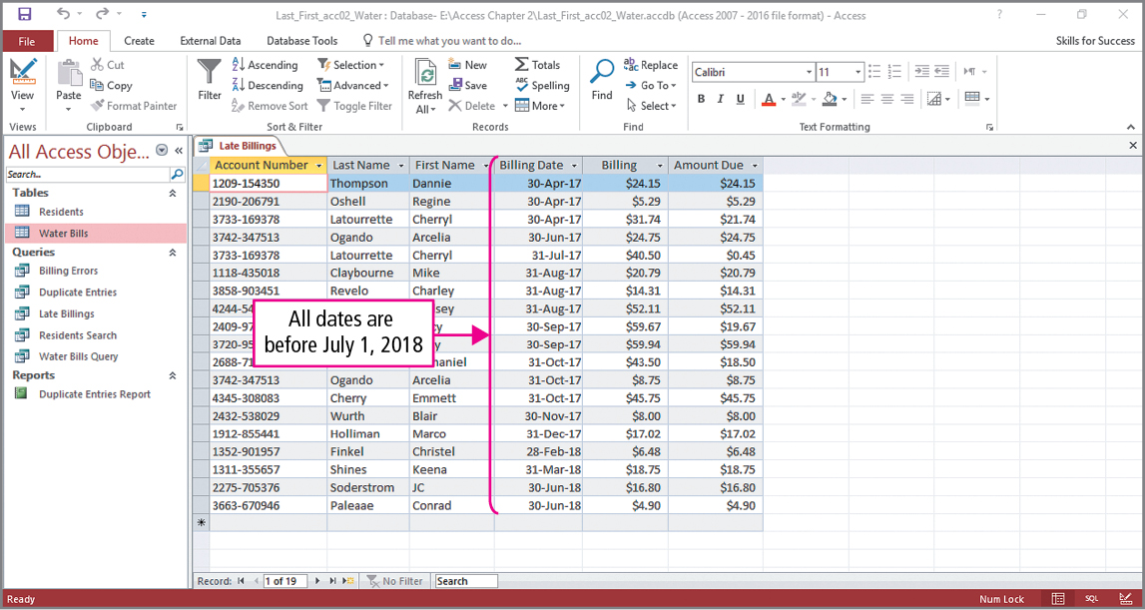
Skill 6: Add Date and Time Criteria (cont.)
Notes:
The results of the query are shown in the slide. The question that is answered is, Which billings before July 1, 2018, still have a balance due?

Slide 26
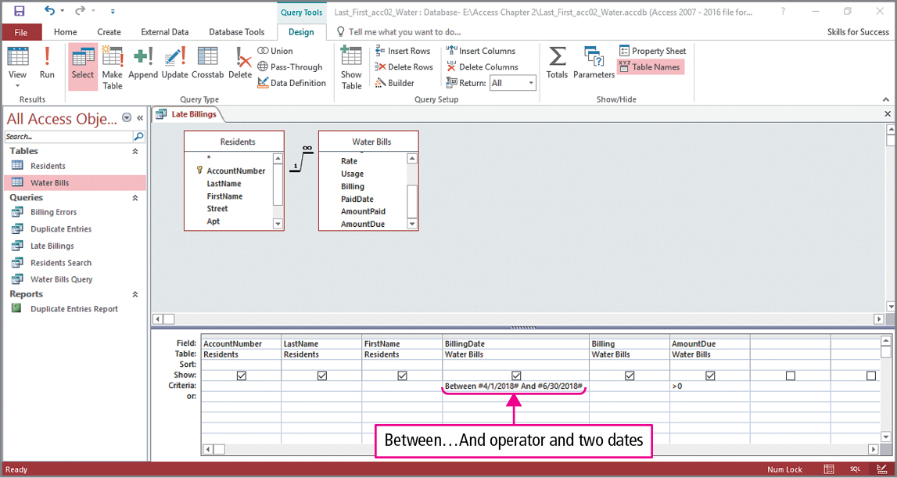
Skill 6: Add Date and Time Criteria (cont.)
Notes:
In this version of the query, we will use the Between…And operator. The Between…And operator is a comparison operator that finds all numbers or dates between and including two values. As seen in the slide, the operator is used to find dates for the months April, May, and June.

Slide 27
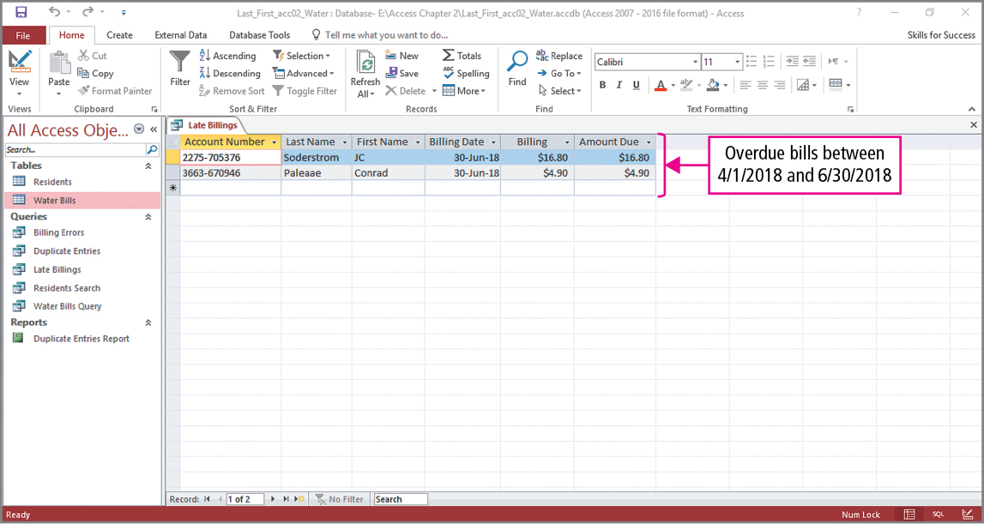
Skill 6: Add Date and Time Criteria (cont.)
Notes:
Running the query displays results to the question, Which billings from the second quarter of 2018 have a balance due?

Slide 28
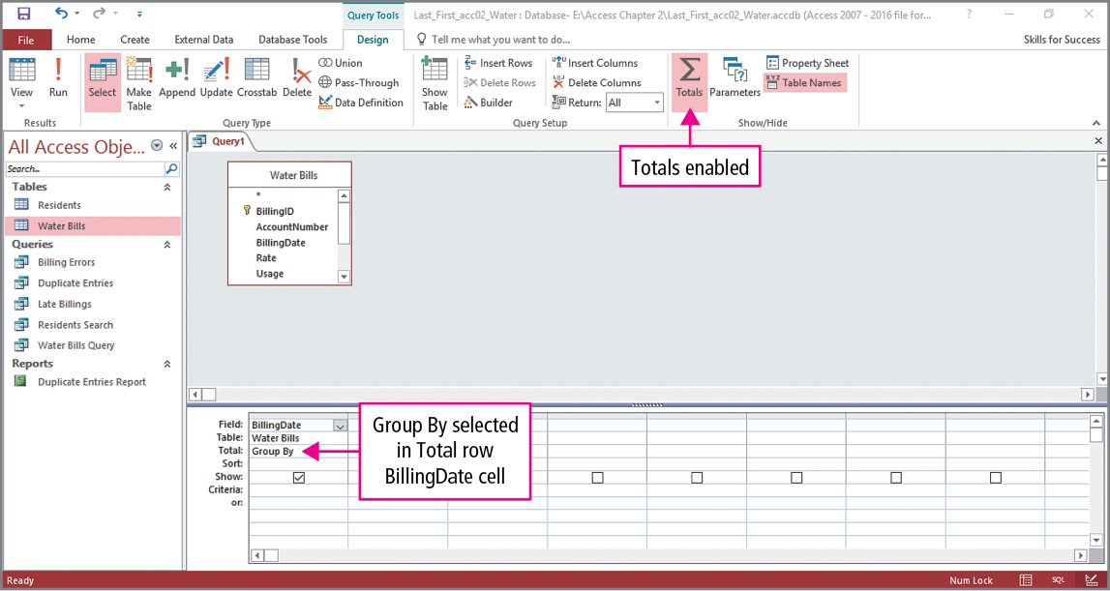
Skill 7: Group and Total Queries
Notes:
A Total row can be added to query display grid when summary statistics such as totals, averages, or counts are needed. As shown in the slide, a Total row has been added by clicking Totals in the Show/Hide group on the Design tab. Notice the default shown in the Totals row is Group By.

Slide 29
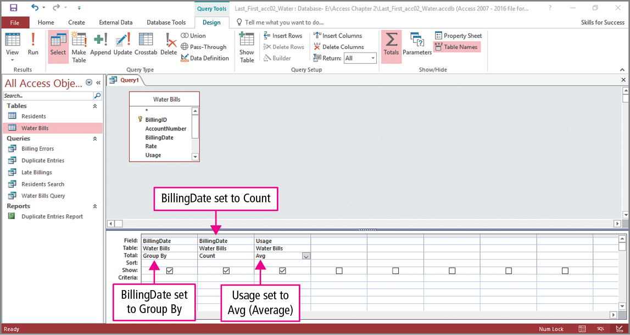
Skill 7: Group and Total Queries (cont.)
Notes:
Two additional fields have been added to the query, one of which is another BillingDate column. To see other options in the Total row, click in the Total row to display the Total row arrow. Clicking the arrow displays a menu of options. As seen in the slide, a count will be performed on the second BillingDate column and an average will be performed on the Usage column. Since no changes were made to the first BillingDate column, the query results will be grouped by dates.

Slide 30
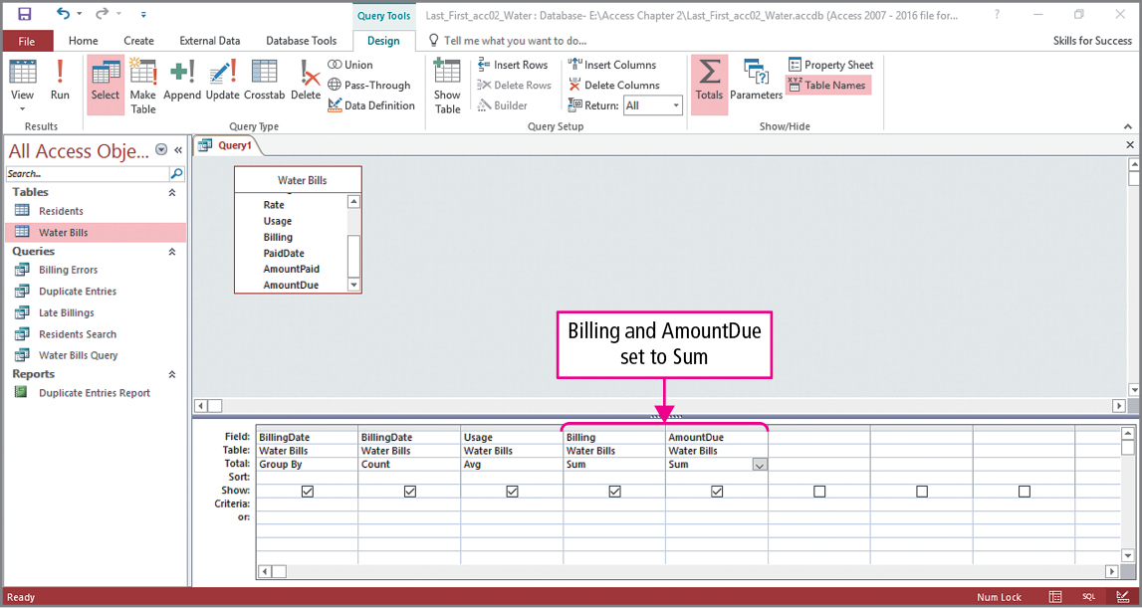
Skill 7: Group and Total Queries (cont.)
Notes:
Two additional fields have been added to the query, and these two columns will have sums performed on them. The Sum operator calculates the total of the values in each group.

Slide 31
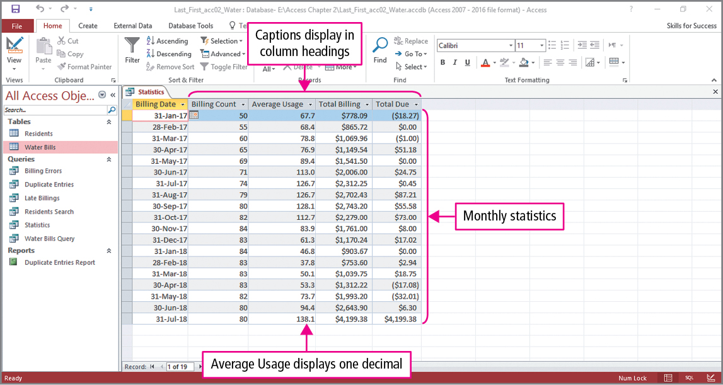
Skill 7: Group and Total Queries (cont.)
Notes:
To display the query results, click Run. Although not shown in the presentation, some of the fields have been formatted by changing their captions and numerical formats.

Slide 32
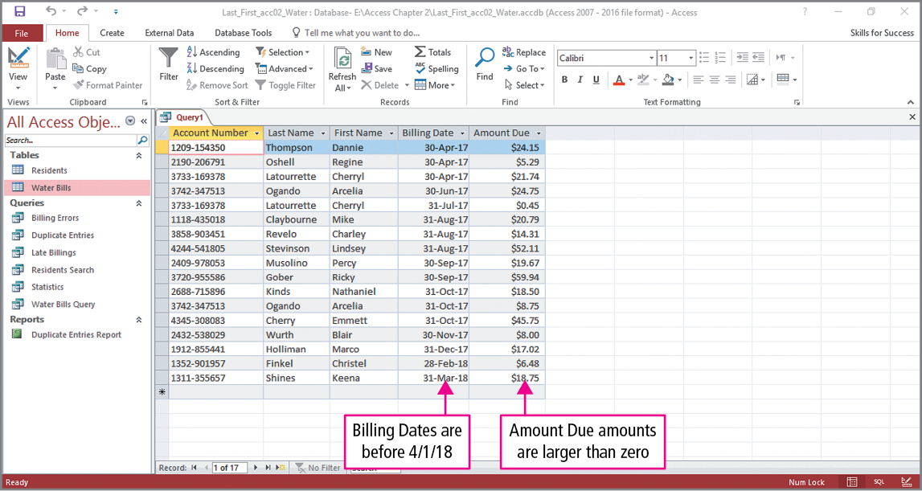
Skill 8: Add Calculated Fields to Queries
Notes:
Calculated fields can be inserted into queries. In queries, calculated fields need an alias, which is a descriptive label used to identify a field in expressions, datasheets, forms, and reports. The query results shown in the table are the result of entering <4/1/14 in the criteria row of the BillingDate column and entering >0 in the AmountDue column. These entries are shown in the next slide.

Slide 33
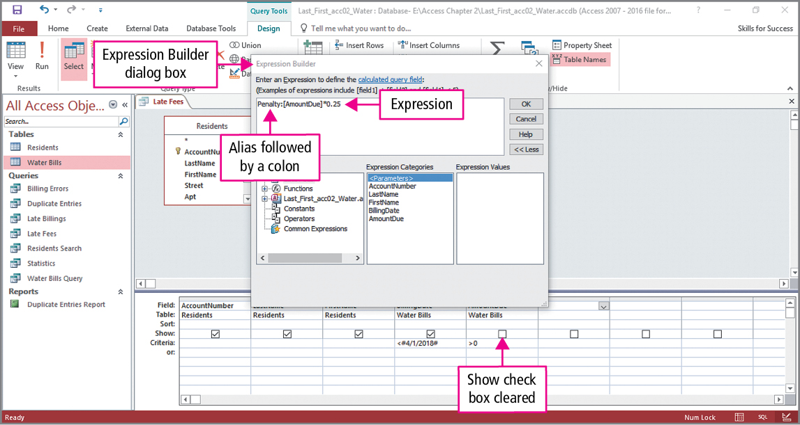
Skill 8: Add Calculated Fields to Queries (cont.)
Notes:
When using Design view, a calculated field is entered using the Expression Builder. In this example, you would click in the first blank column Field row, and then click the Builder button in the Query Setup group. As seen in the slide, Penalty: [AmountDue] * 0.25 was typed in the Expression Builder dialog box. Penalty will be the alias for the calculated field, which calculates 25% penalty for late payments. Notice that Show for the AmountDue field has been unchecked. It has to be in the query for the calculated field, but this field will not show in the query results.

Slide 34
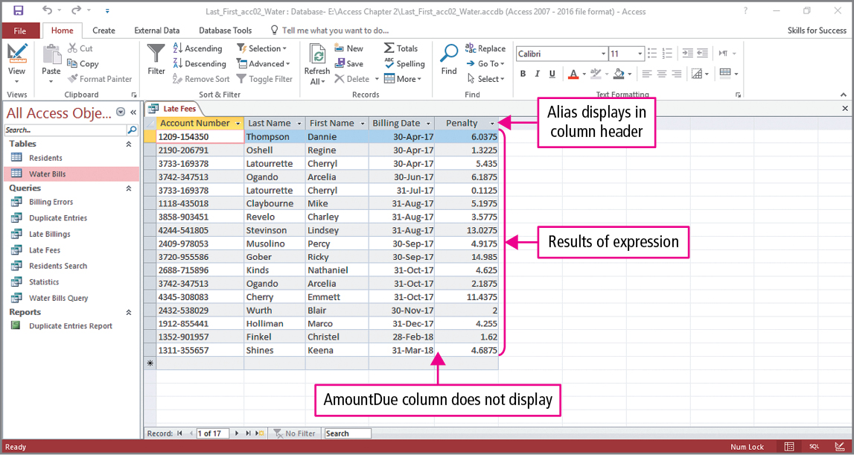
Skill 8: Add Calculated Fields to Queries (cont.)
Notes:
Notice that the Penalty alias displays as the column header. However, the values that are displayed in the column need to be formatted. An alias is a descriptive label used to identify a field in expressions, datasheets, forms, and reports.

Slide 35
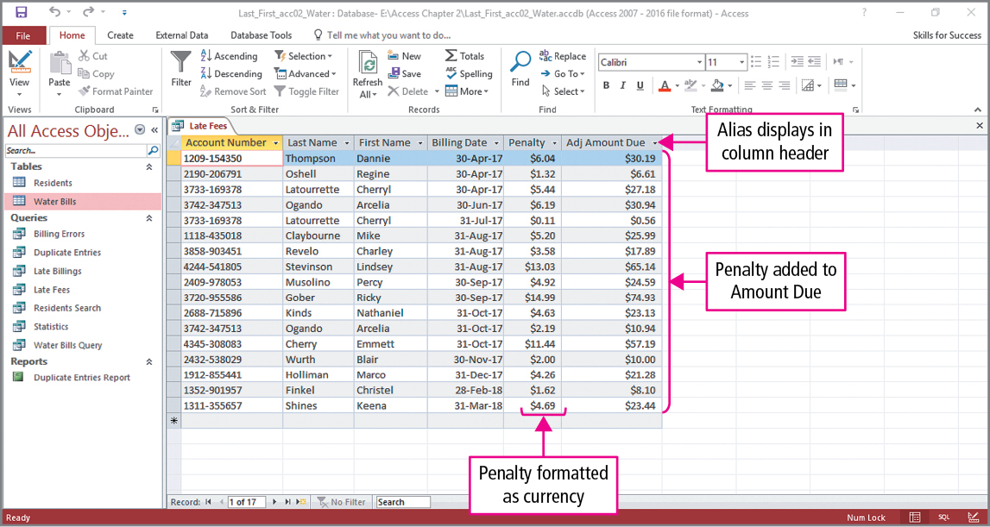
Skill 8: Add Calculated Fields to Queries (cont.)
Notes:
A final column will be added to reflect the addition of a penalty. Expression Builder would be used once again to enter: Adj Amount Due: [AmountDue] + [Penalty]. The last two columns have formatted to Currency using their property sheets.

Slide 36
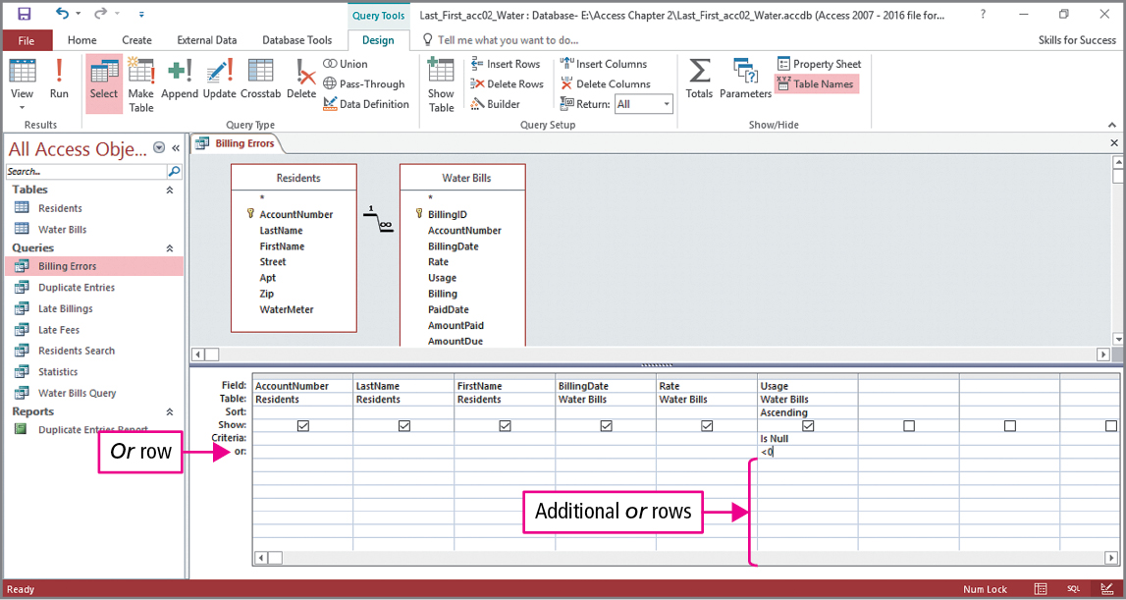
Skill 9: Work with Logical Operators
Notes:
In this example, we are going to use a query to find erroneous entries. We begin by looking for errors in the Usage, where an error is a negative number or an empty entry.
When criteria are used in more than one column, the placement of the criteria in the design grid rows determines whether one or both of the criteria must be true for the record to display. In this query, we will see how to apply multiple criteria. In the Criteria row of the Usage column Is Null has been added. The Is Null and Is Not Null operators test if a field is empty or not empty. In the Or row of the Usage column is <0. When run, this query will find records where the usage is empty or negative.

Slide 37
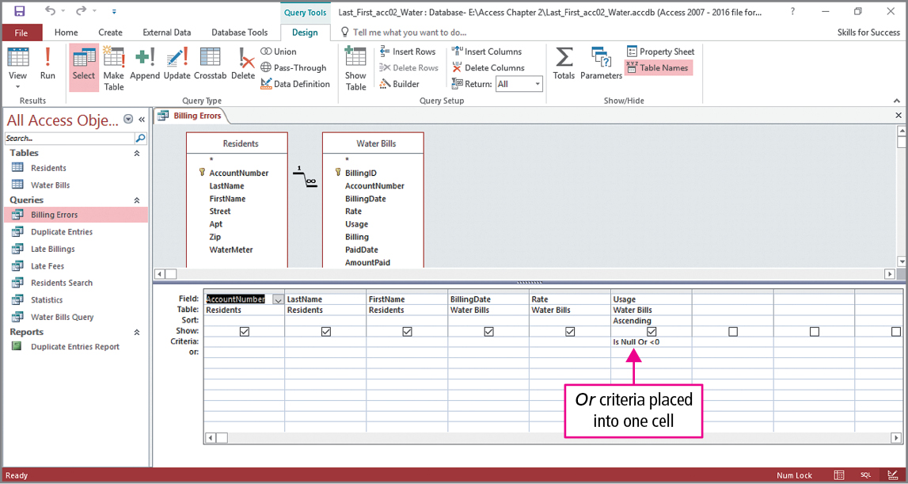
Skill 9: Work with Logical Operators (cont.)
Notes:
After running the query and returning to Design view, look at the Criteria row in the Usage column. When two criteria are placed in different rows in the design grid, the Or logical operator is applied. Since the two criteria in this query can be combined into a single row, Access automatically placed the Or logical operator between. In a similar manner, we want to find errors in the Rate field. Another criterion will be added in the Criteria row of the Rate column, and Null Or <=0 would be typed in the cell.

Slide 38
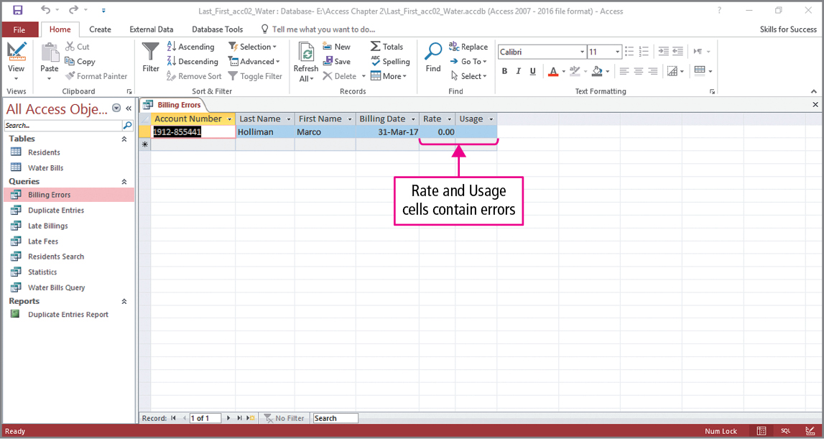
Skill 9: Work with Logical Operators (cont.)
Notes:
When the query is run, only one record is displayed. When two criteria are placed in the same row, the And logical operator is applied. Here, records are selected only where the Usage and Rate columns both have errors. This will be corrected on the next slide.

Slide 39
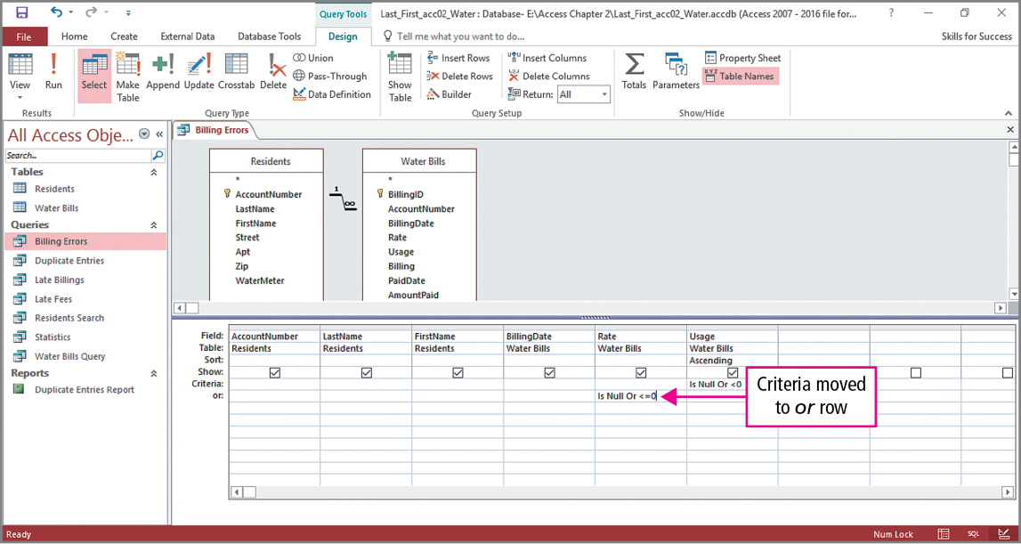
Skill 9: Work with Logical Operators (cont.)
Notes:
In the final slide, we want to find erroneous entries in either of the Rate or Usage columns. As seen in the slide, Is Null Or <=0 has been deleted from the Criteria row and has been typed in the Or row of the Rate column. When this query is run, six erroneous records will be displayed.

Slide 40
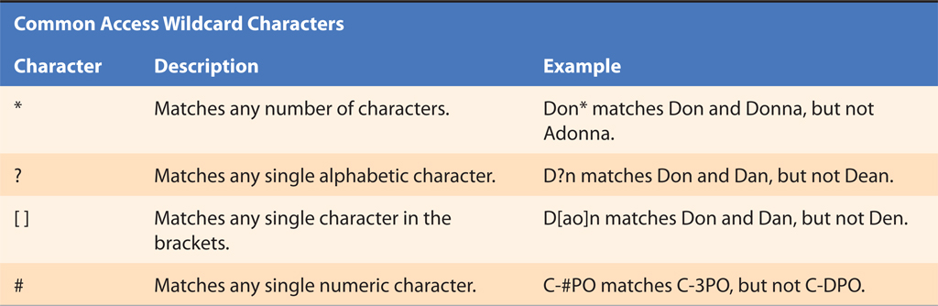
Skill 10: Add Wildcards to Query Criteria
Notes:
A wildcard is a special character, such as an asterisk or question mark, used in query criteria to allow matches for any combination of letters or characters. Wildcards can expand search criteria to find a more accurate subset of the data. Take a few moments to study this table and read the descriptions and examples of these wildcards.

Slide 41
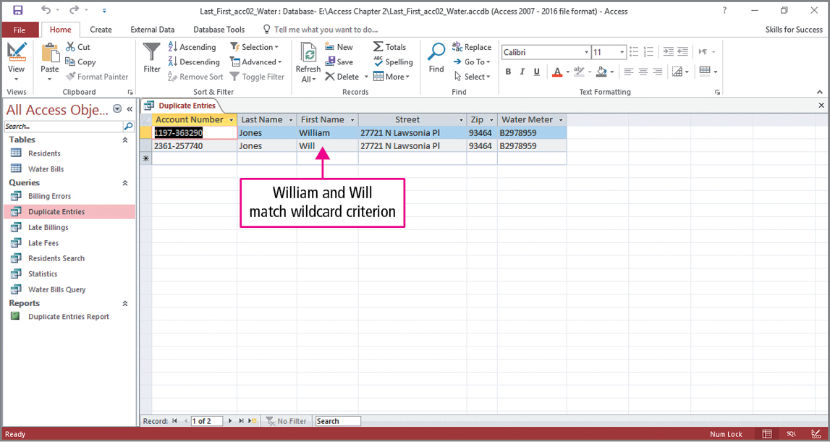
Skill 10: Add Wildcards to Query Criteria (cont.)
Notes:
In this query, we are trying to find duplicate entries. In Design view, Jones was entered in the Criteria row of the Last Name column, Will* was entered in the Criteria row of the First Name column, and then the query was run. As described on the previous slide, the asterisk wildcard character matches any combination of characters, and as seen in the slide, two first names begin with Will but end differently.

Slide 42
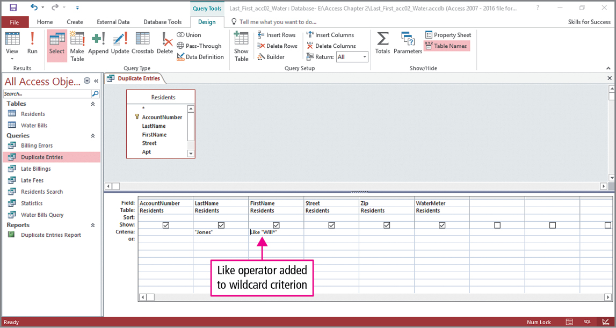
Skill 10: Add Wildcards to Query Criteria (cont.)
Notes:
Switching back to Design view, we see that Access has added the Like operator and quotation marks to our criteria.

Slide 43
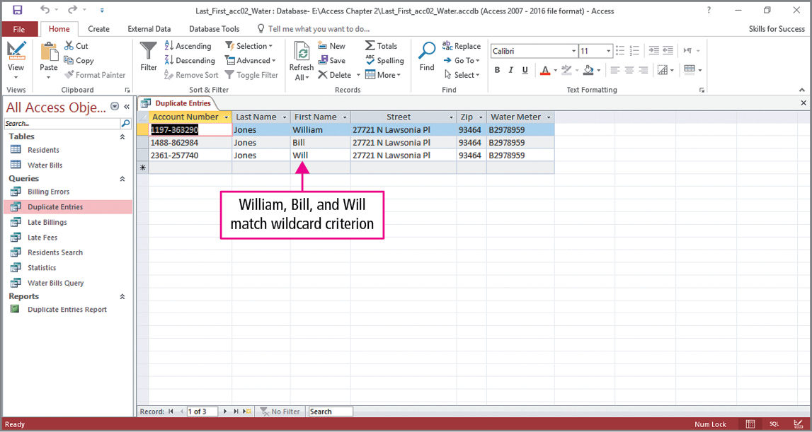
Skill 10: Add Wildcards to Query Criteria (cont.)
Notes:
In the final example, Will* is replaced by ?ill*. Remember the table explained that a question mark wildcard character matches any single character. Look at the results of the query shown in the slide, and be sure you understand why Bill, Will, and William are displayed.

Slide 44
More Skills For Success
You will now practice the following additional skills:
Export Queries to Excel
Export Queries as Web Pages
Link to External Data Sources
Create Crosstab Queries
Notes:
You will now practice the following additional skills:
Export Queries to Excel
Export Queries as Web Pages
Link to External Data Sources
Create Crosstab Queries

Slide 45
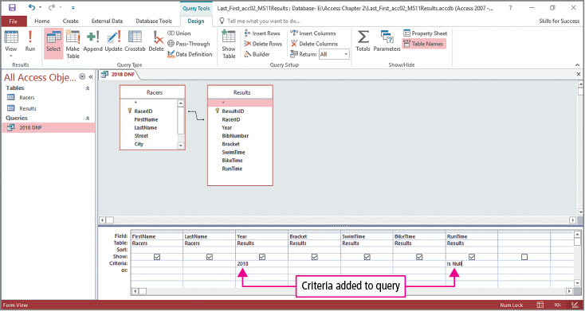
More Skills 11: Export Queries to Excel
Notes:
Data from a table or query can be exported to other applications such as Excel and Word. When using Excel, you can analyze query results by adding summary statistics and charts. The two tables shown in the slide represent information on racers and their results. The query is to find which racers did not finish a race in 2018. As seen in the query design grid, 2018 has been entered in the Criteria row for the Year, and Is Null has been entered in the Criteria row for the RunTime column. When the query is run, 19 records would display.

Slide 46
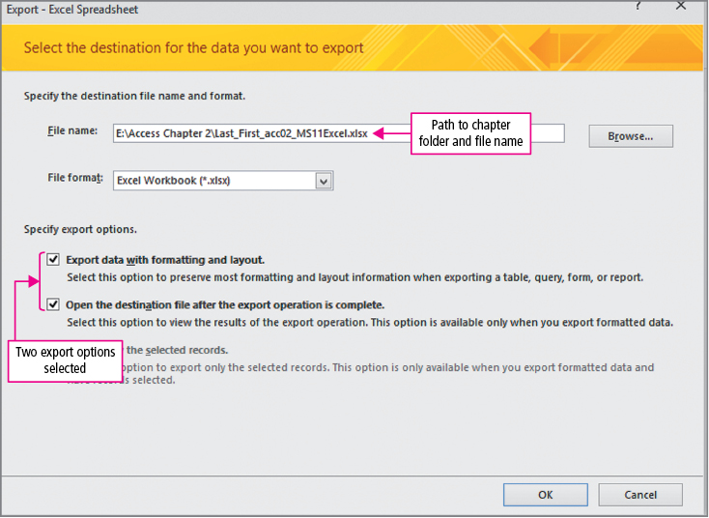
More Skills 11: Export Queries to Excel (cont.)
Notes:
The results of the query will be exported to Excel. This is done by clicking Excel in the Export group on the External Data tab, which opens the Export - Excel Spreadsheet dialog box. In this dialog box, the Excel file type is selected, and you would browse to the location where the file will be saved.

Slide 47
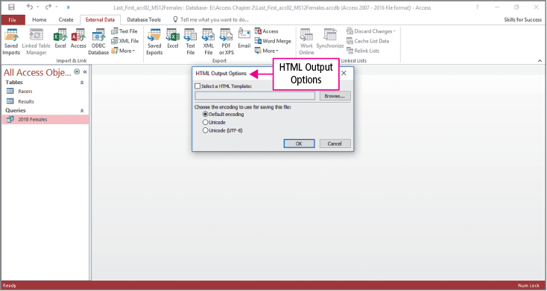
More Skills 12: Export Queries as Web Pages
Notes:
In the previous skill, we saw how to export an Access query to an Excel spreadsheet, and in this example, we will export a query as a web page, which can make the results available on the Web. An HTML document is a text file with instructions for displaying its content in a web browser. When the file is placed on a web server, the web page can be viewed on the Internet.

Slide 48
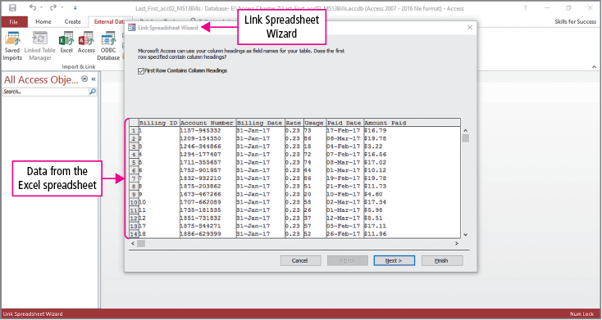
More Skills 13: Link to External Data Sources (cont.)
Notes:
Access can use data stored in a linked table, which is a table that exists in a different file created by an application such as Access or Excel. Once a linked table is inserted, it can be used to create queries and reports. To update the data, the file must be opened in the application that created it.

Slide 49
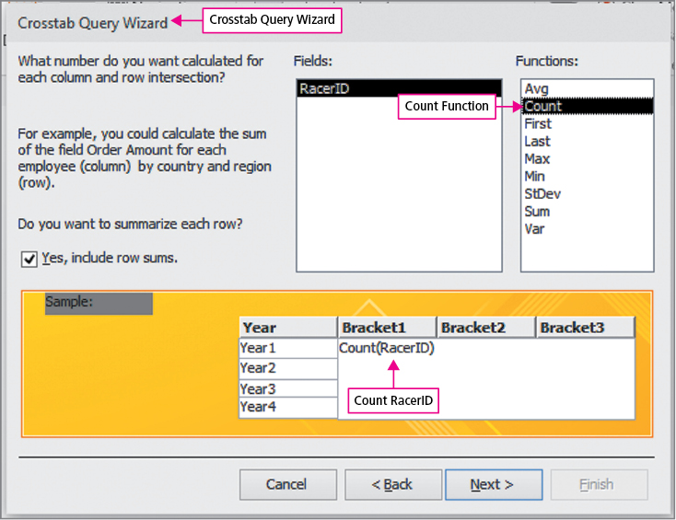
More Skills 14: Create Crosstab Queries
Notes:
A crosstab query is a query that calculates sums, averages, or similar statistics, and then groups the results by two sets of values. A crosstab query displays one group down the side of the datasheet and the other group across the top of the datasheet. For example, using the racing database from an earlier skill, you could display racers’ names on the left and race results across the top.

Slide 50
Summary
Queries
Simple Query Wizard
Calculated fields
Group and summary statistics
Criteria
Comparison operators
Logical operators
Wildcards
Notes:
Queries are used to ask questions about the data stored in database tables. They can be created using the Simple Query Wizard or in Design view.
Criteria are conditions that can be added to a query to select which records are displayed.
Query results can be grouped and have summary statistics applied to them.
Criteria are conditions that can be added to a query to select which records are displayed and can include:
Comparison operators
Logical operators
Wildcards

Slide 51
Questions
Notes:
As you complete this introduction to Access, be sure you ask questions. You want to understand the concepts so that you can continue to build on them in future chapters.

Slide 52

Copyright
All rights reserved. No part of this publication may be reproduced, stored in a retrieval system, or transmitted, in any form or by any means, electronic, mechanical, photocopying, recording, or otherwise, without the prior written permission of the publisher. Printed in the United States of America.

